Slide 1
Tax Preparation
Course Introduction
Notes:
Instructor Notes:
This lesson is designed to introduce new volunteers to your district training program and could be part of your New Volunteer Orientation (if applicable) or at the start of classroom training
It assumes that New Volunteers would attend some form of classroom training
Instructors
Need to fill in their state information on Slide 7
Slides 8 and 9 are intentionally blank and need to have information added for your training program
Need to fill in the required practice returns from the NTTC Workbook on Slide 15
The NTTC recommends at least four practice returns to demonstrate competence with the software
Some slides have suggested talking points
They should be modified to meet the needs of our volunteers and your district
The District Training Coordinator/Instructors should review the content of all the slides and make modifications as necessary to support their training program objectives
This lesson focuses on the federal return
Instructors should add slides for state return training as necessary

Slide 2
Volunteer Courses
Courses required of all volunteers
  Volunteer Standards of Conduct (VSC)
    IRS Publication 4961
  Intake/Interview and Quality Review
    IRS Publication 5101
  Policy and Procedure Training in class*
    *Limited case by case exceptions
Notes:
While the first two courses can be presented in a classroom setting, many districts have new volunteers and counselors study the material on their own, take and pass the exam on-line, and print and sign the Volunteer Agreement as part of New Volunteer Orientation prior to tax law/TaxSlayer training
IRS requires that all new volunteers must take the course on Intake/Interview and Quality Review
Policy and Procedure Training, however, is required to be presented by Instructors to all counselors, typically at orientation
District Coordinators may grant limited case by case exceptions but no blanket district or site exceptions may be granted

Slide 3
Counselor Tax Courses
Tax Law
  Basic
    Not required for Tax-Aide counselors
  Advanced
    Required for all Tax-Aide counselors
Optional specialty courses
  Health Savings Accounts (HSA) certification
  Military certification
  International certification

Slide 4
IRS Materials
Pub 4012
  Volunteer Resource Guide
Pub 4491
  Volunteer Training Guide
Pub 17
  Federal Income Tax For Individuals
IRS Forms and Publications applicable to training
Notes:
Both Pubs 4012 and 4491 have NTTC supplemental information to provide more details to aid Counselors

Slide 5
TaxSlayer Software Materials
TaxSlayer Pro is the software
TaxSlayer Practice Lab
  Practice software
  Practice problems with answers
  Training videos and recorded webinars
  Training materials for download

Slide 6
Tax-Aide Materials
National Tax Training Committee (NTTC) Workbook
  Training Exercises for classroom instruction
  Practice problems and quizzes
  Separate Instructor Guide to NTTC Workbook (electronic version only)
Qualifying Child / Qualifying Relative Resource tool for tax counselors
  “Tri-fold” used during training and tax preparation

Slide 7
Tax-Aide Materials cont.
Resource Library on the AARP Portal
  Volunteer Resource Guide with NTTC notes
  Volunteer Training Guide with NTTC notes
  Scope Manual
  Many other helpful documents

Slide 8
State and Local Materials
List here any State and Local materials you use
  [i.e. Michigan Taxpayers Assistance Manual]
  [i.e. Michigan Tax Text]
  [i.e. https://www.michigan.gov/taxes]
List here any State and Local Tax-Aide materials
  [i.e. User Guide for Michigan Returns]
Notes:
This is the place to list local materials unique to your training area

Slide 9
Pre-Class Requirements
Notes:
Instructors should list those items that they want volunteers to complete prior to coming to the first day of class
Items could include:
Reviewing the Course Objective chapter of Pub 4491 and briefly familiarizing themselves with the Training Guide’s contents
Completing the Volunteer Standards of Conduct Course (Pub 4961) and certification exam on Link and Learn Taxes
Completing the Intake/Interview & Quality Review Course (Pub 5101) and taking the certification exam on Link and Learn Taxes
Printing a copy of the Volunteer Agreement from Link and Learn Taxes showing they passed one or both exams above.
Alternatively they could be asked to fill out the Volunteer Agreement form in Pun 6744 and bring it to class. This could also be done during their orientation if applicable
Alternatively, they can take the two tests and submit the Volunteer Agreement after they complete their certifications
Open and assemble their Pub 4491 and familiarize themselves with the contents
Open and assemble their Pub 4012 and familiarize themselves with the contents – this will be late January

Slide 10
Training Agenda
Notes:
This slide can be used to show the class agenda or schedule and additional slide can be added as necessary

Slide 11
Volunteer Resource Guide – Pub 4012
Written specifically for the VITA/TCE program
Contains everything needed to pass all tests
Will be available Online early November
Printed version will be delivered late January
Notes:
The idea of this slide is to demonstrate the value of the Resource Guide and get the volunteers to adopt Pub 4012 as their “Go To” reference not only during training but at the site throughout the tax season
Instructors can highlight the pages that they feel would illustrate the function and value of Pub 4012
Volunteers are encouraged to add any notes or highlighting to enhance their use of this publication

Slide 12
Volunteer Resource Guide – Pub 4012
NTTC-Modified Pub 4012 recommended
  Online only, no printed version
  Latest version always in Portal Library
  Available December with January Update
  Best reference for Tax-Aide scope
IRS version has scope differences from Tax-Aide
Notes:
Areas to emphasize:
The value of the NTTC-Modified Pub 4012 and get the volunteers to adopt the modified guide
Instructors should have counselors practice with NTTC-modified Pub 4012 often
Instructors should practice using NTTC-modified Pub 4012 online
Pause during each class and have counselors find answers to posed questions, determine scope for a variety of situations and become familiar with the layout and format of the Guide
Becoming familiar now with the online version will save time during tax season
Benefit of online only: continually updated

Slide 13
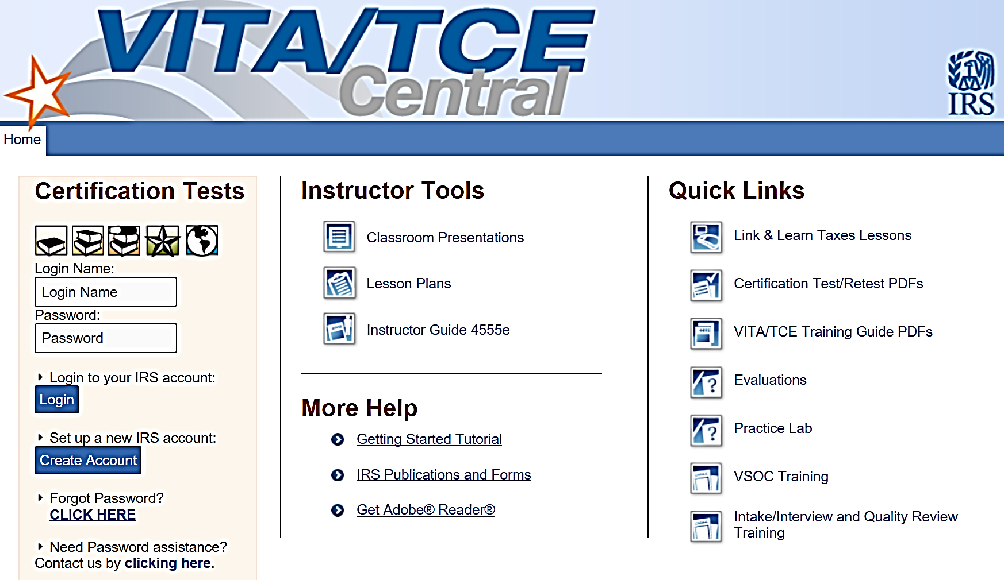
https://www.linklearncertification.com
This is where you will go to take your tests
Notes:
Having all new volunteers log-in and explore this site under Instructor direction would be an excellent topic at New Volunteer Orientation
Instructions for logging in and taking the tests on line can be found in the Portal Library

Slide 14
https://www.linklearncertification.com
Direct links to:
  Online tests for certification
  Training Lessons
  Link and Learn On line Lessons
Tax-Aide Scope differs in some areas from VITA scope
Notes:
Have the counselors create an account and verify everyone can login
Remind counselors they will need to remember their username and password

Slide 15
Certification Process
Counselors must pass three tests to meet IRS/AARP Tax-Aide certification requirements
  Volunteer Standards of Conduct (VSC) Test
  IRS Intake/Interview & Quality Review Test
  Advanced Test
Each test must be passed with score of 80% or better
  One retest available for each test

Slide 16
Certification Process
Certification also requires that you prepare the following practice exercises:
  A
  B
  C
  D
Exercises must be completed as “ready to file” and will be reviewed by an Instructor
Notes:
The number of required exercises may be established by your State Coordinator
AARP Tax-Aide recommends a minimum of four exercises
The specific exercises maybe determined by the State Management Team
If not specified, Instructors may want to select exercises that most reflect those the volunteers will encounter at their sites during tax season
The NTTC Workbook has a variety of exercises to choose from and exercises can be modified as necessary to meet each District’s needs

Slide 17
Filing Returns
All taxpayers must complete the Intake Booklet
  Counselors and Reviewers review with taxpayer and annotate additional information
All returns completed on computer
  TaxSlayer® software supplied by IRS
All returns must have Quality Review
  Second counselor reviews completed return for accuracy
Tax returns are e-filed whenever possible
Each taxpayer signs return

Slide 18
Volunteer Responsibilities
Stay within scope of program
  If counselor is unfamiliar with a tax situation, return is out of scope for that counselor
Become familiar with and use resources
  IRS Pubs: emphasis on Pub 4012
  AARP resource materials and IRS help facilities
  State materials and help facilities
  Fellow counselors
  AARP Tax-Aide Cybertax Alerts
Notes:
These are the responsibilities covered in AARP Tax-Aide Policies and Procedures
Instructor can add additional responsibilities established by their districts

Slide 19
Volunteer Responsibilities
Understand and communicate: tax return is client’s responsibility
Protect confidentiality and security
Do not retain any data at site
Record all activity at site every shift
Follow site’s e-file process

Slide 20
Volunteer Protection Act of 1997
Certified volunteers not liable if:
  Received IRS/AARP Foundation Tax-Aide Training
  Action is not wilful
  Act within scope of program and training
  AARP Foundation Tax-Aide policies and procedures are followed

Slide 21
Course Introduction
Questions?
Comments…

